Slide 1


SMART INDIA HACKATHON 2026
Problem Statement ID – SIH26139
Problem Statement Title- Hybrid Quantum Machine Learning Platform for Early Disease Detection .
Theme- HealthTech
PS Category- Software
Team ID-178234
Team Name- AlgoX

Slide 2
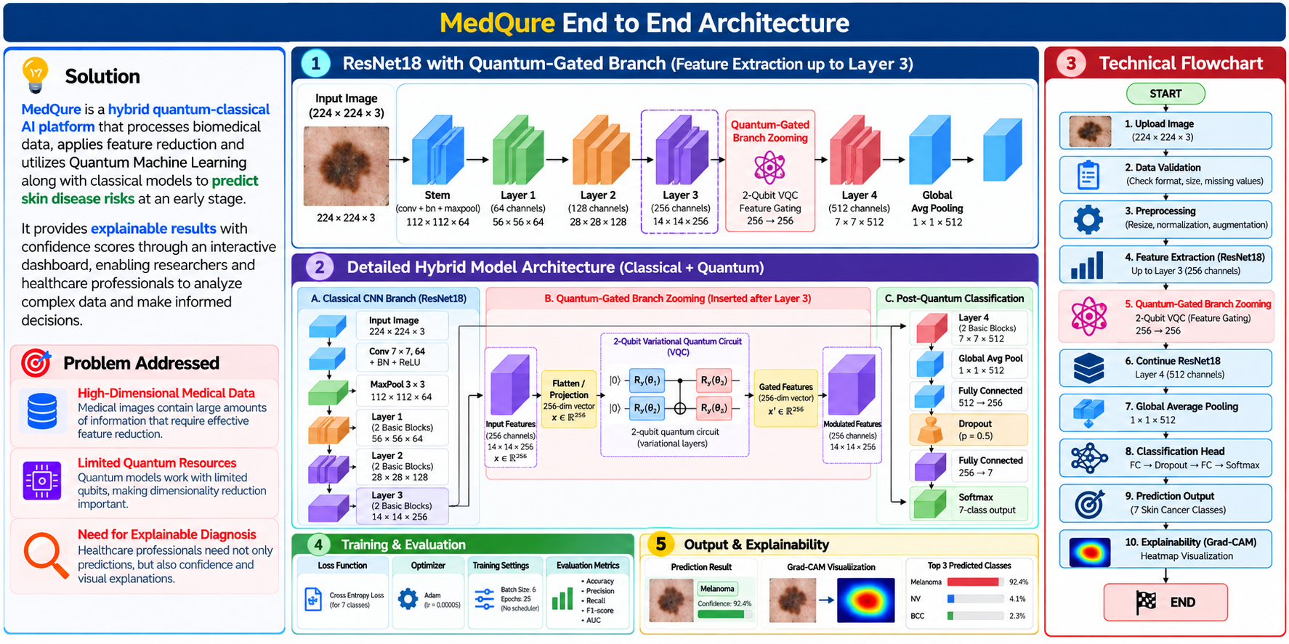
MedQure Proposed Solution

Slide 3
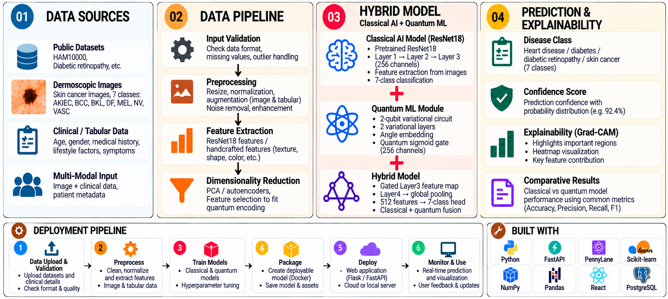
TECHNICAL APPROACH

Slide 4
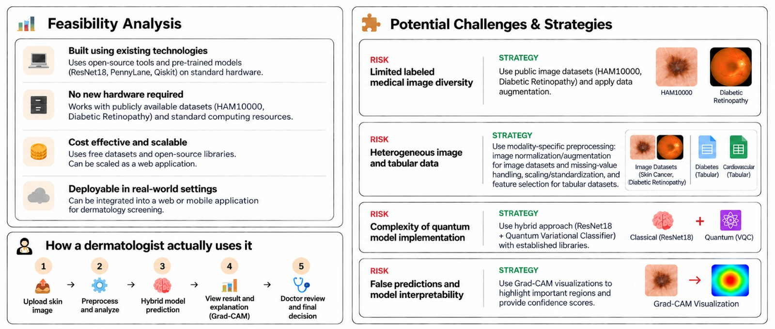
FEASIBILITY AND VIABILITY
Use publicly available datasets such as HAM10000 and a Diabetic Retinopathy dataset, along with data augmentation.
HAM10000
Diabetic Retinopathy
dataset

Slide 5

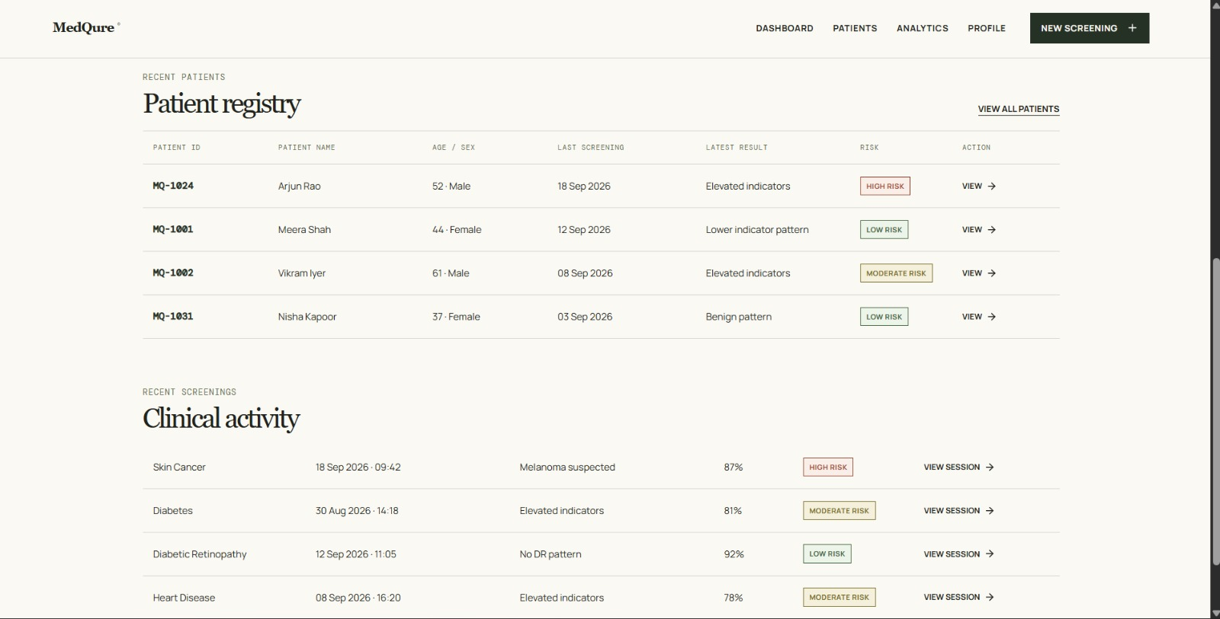
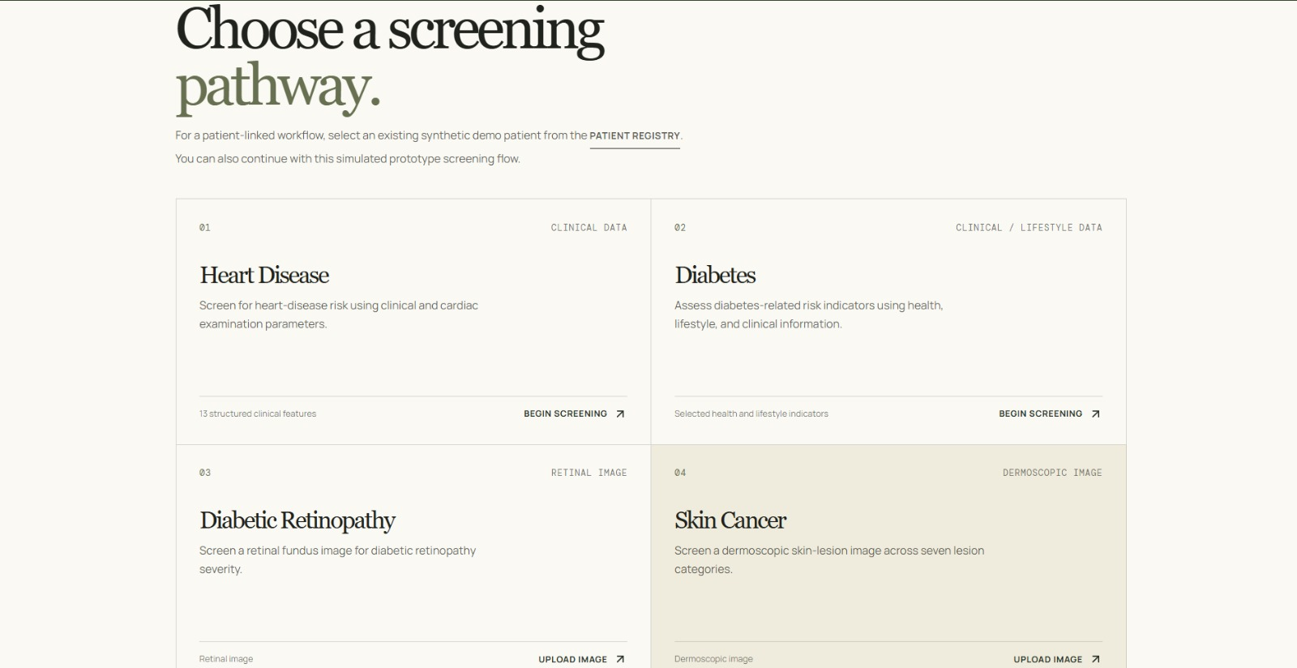
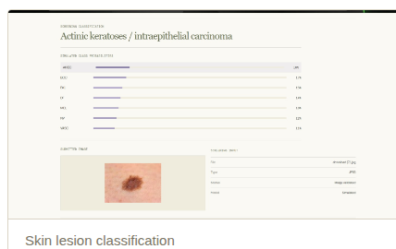
PROTOTYPE UI
GitHub: https://github.com/7pavana/SIH-AlgoX

Slide 6
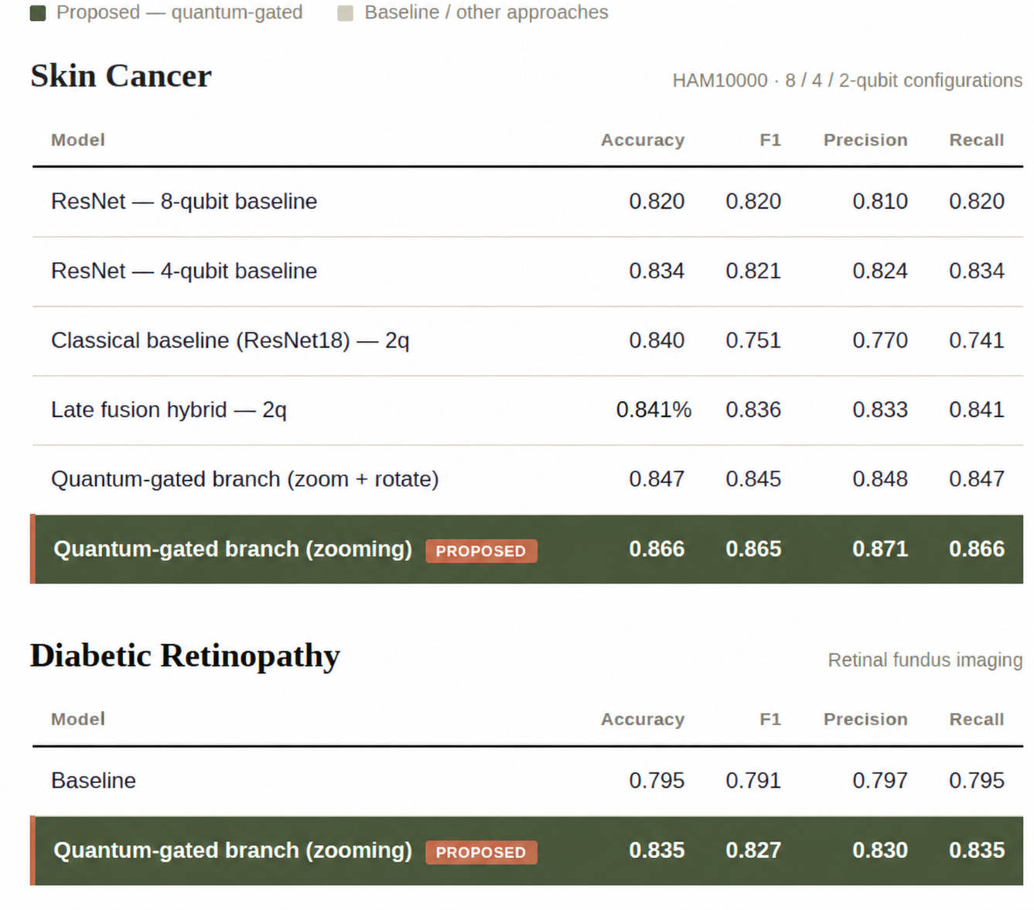
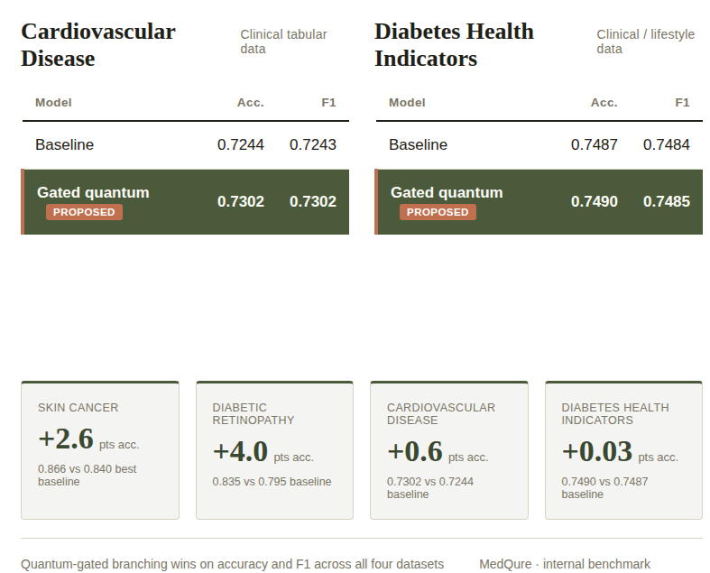
RESULTS

Slide 7

IMPACT AND BENEFITS

Slide 8










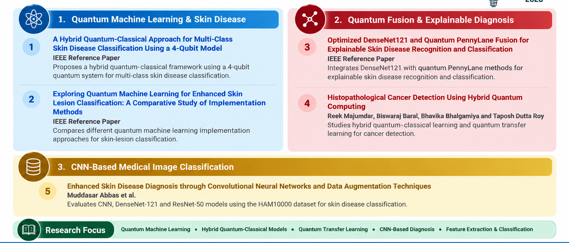
RESEARCH AND REFERENCES

